Slide 1
Figure 1
Simulator introduction and details

Slide 2
boundary fluxes
cell growth rate
short timestep
ODE model
numerical integration
genome-scale metabolic flux predictions
local metabolite/ enzyme concentration predictions
FBA model
ode integration
fba optimization
linear optimization
internal pathway fluxes
long timestep
simulation

Slide 3
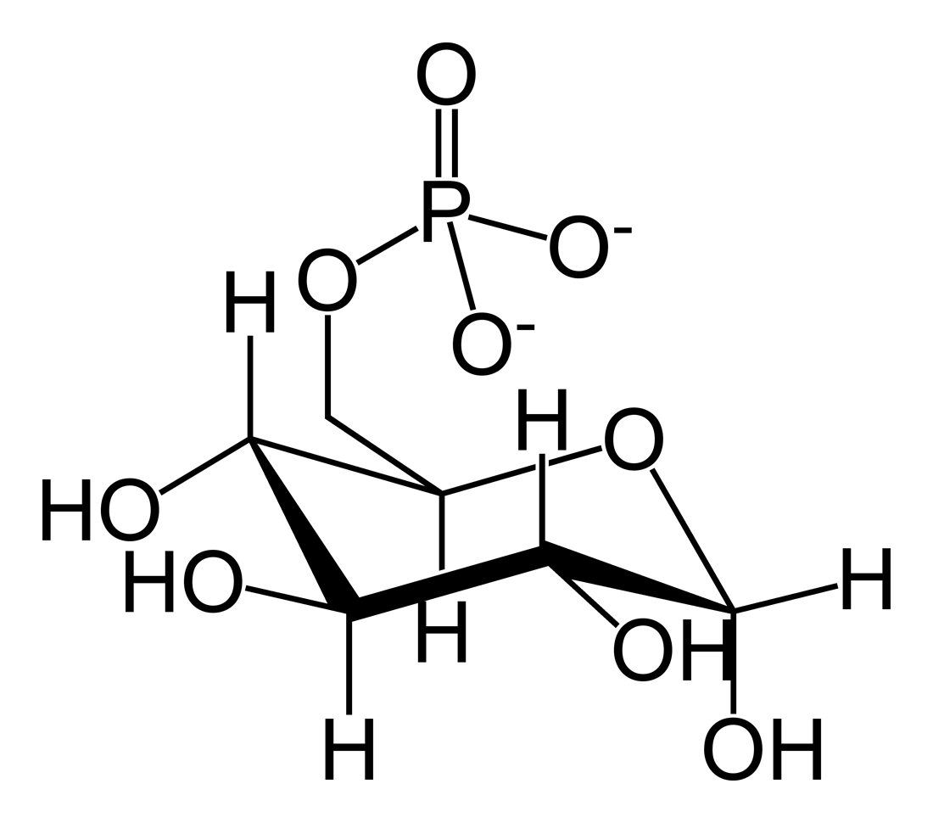
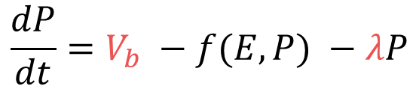

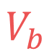
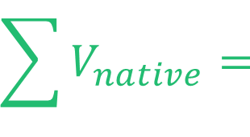

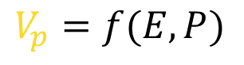
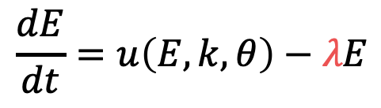
FBA model
ODE model
iML1515 complete E.coli
metabolic model
$$V_{p}$$
$$\frac{dP}{dt}=V_{b} −f(E, P) −λP$$
precursor
pathway flux
$$\frac{dE}{dt}=u\left(E, k, θ\right)−λE$$
flux aggregation
boundary flux(es)
$$\sum{V_{native}= }$$
$$V_{p}=f(E, P)$$
$$V_{b}$$
pathway fluxes constrain next FBA
integrated from time t to t+1
to record concentrations P, E
growth rate
objective function
$$λ$$

Slide 4
Generation of training data
FBA linear optimization
pathway flux
feasibility
boundary flux
growth rate
Model training
feasibility
logistic regression
pathway flux
boundary flux
neural network
growth rate
linear regression

Slide 5
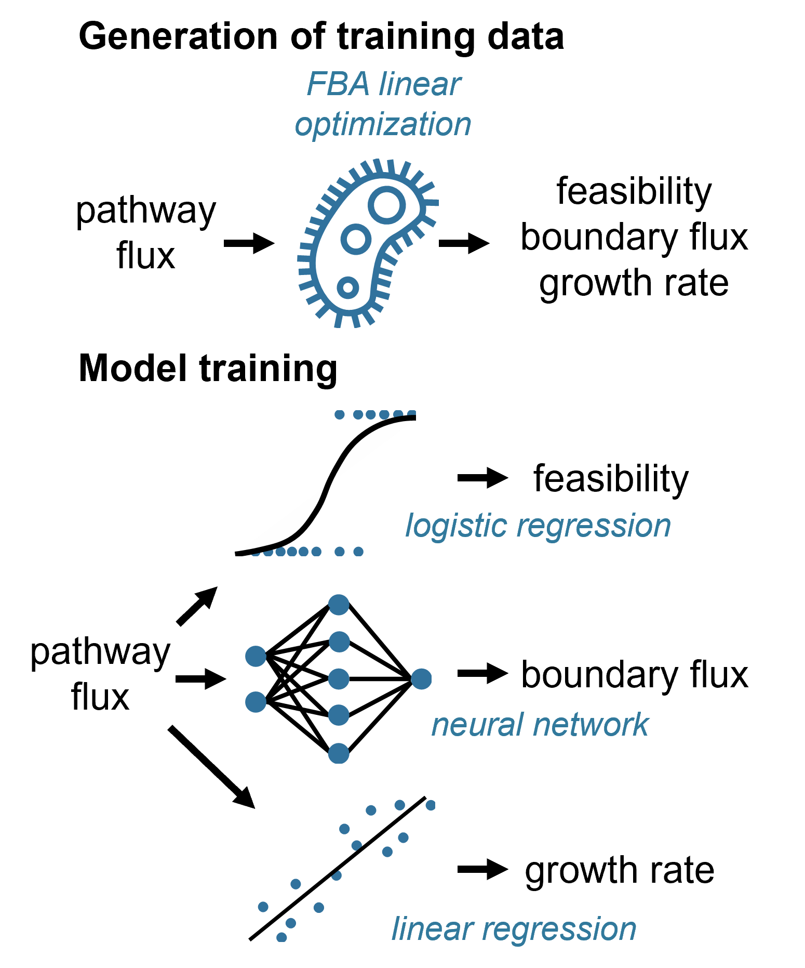
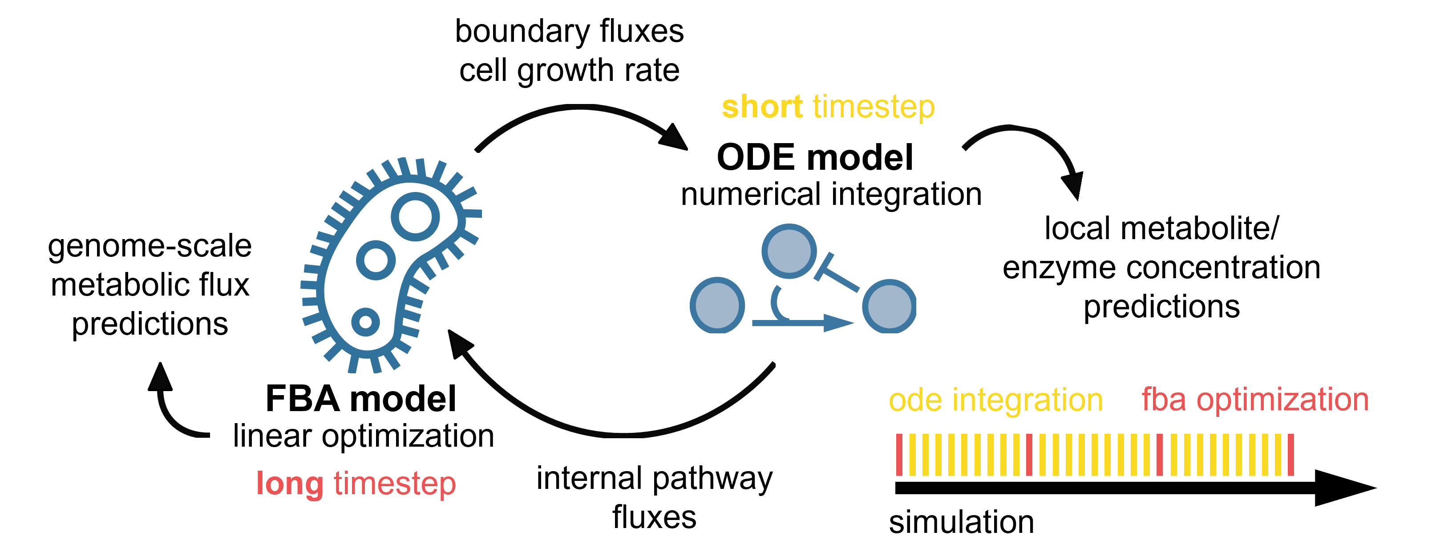
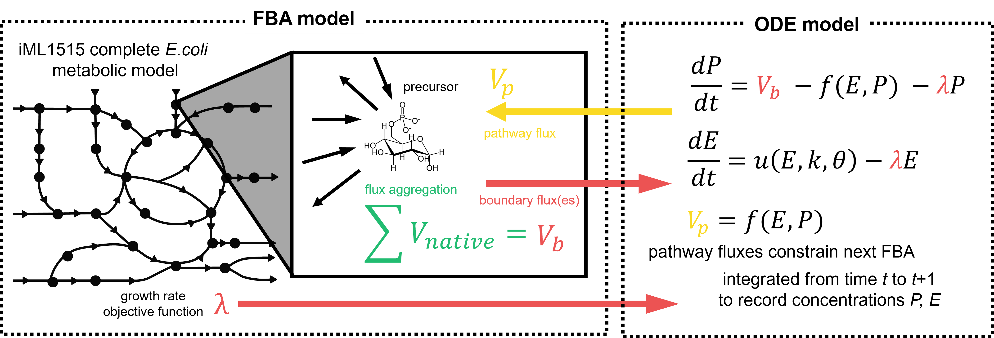
A
C
B

Slide 6
Figure 2
Case studies and sample trajectories

Slide 7
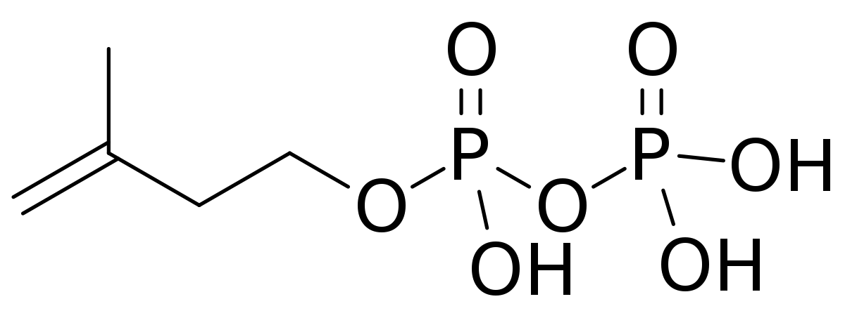
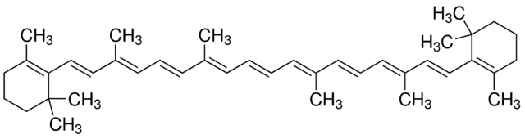
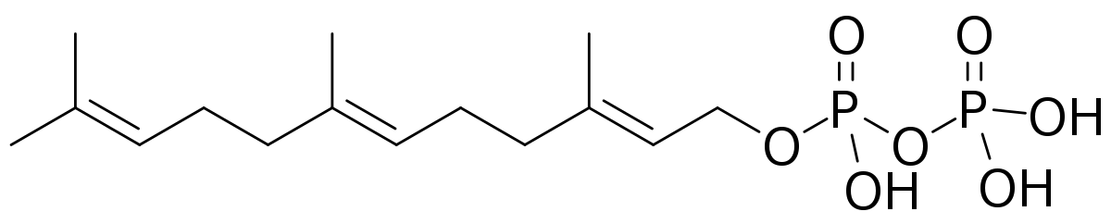
IPP
V_{ipp}
V_{in}
crtE
crtB
crtI
crtY
GGPP
Phytoene
Lycopene
FPP
β-carotene
V_{fpp}

Slide 8
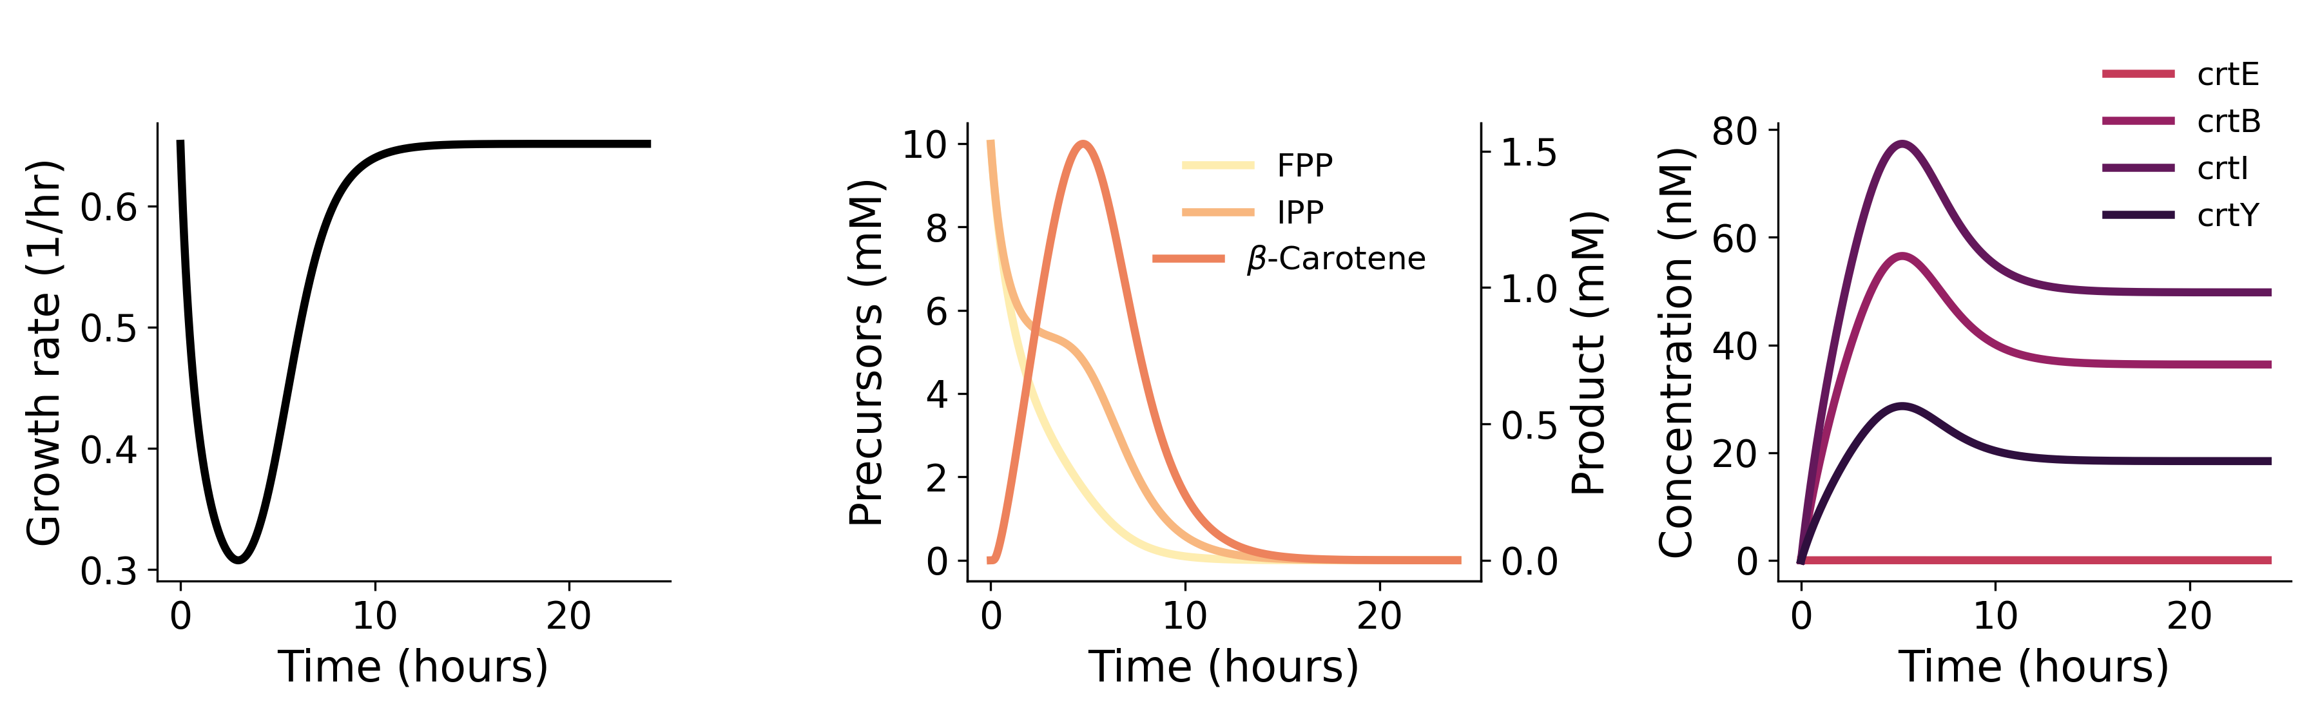
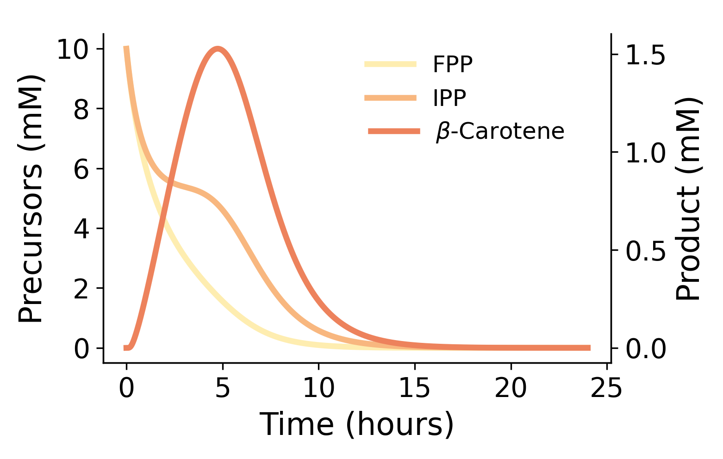

Slide 9
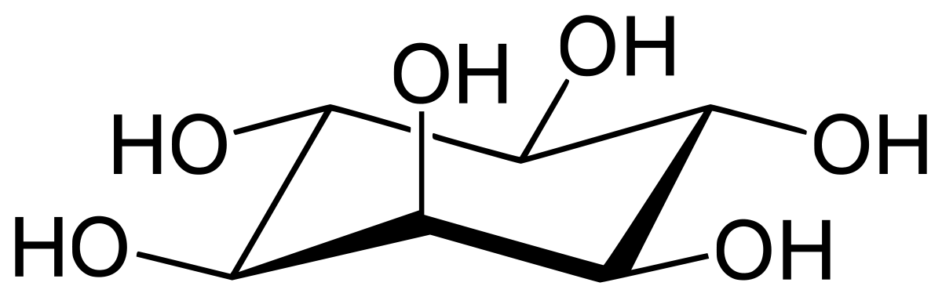
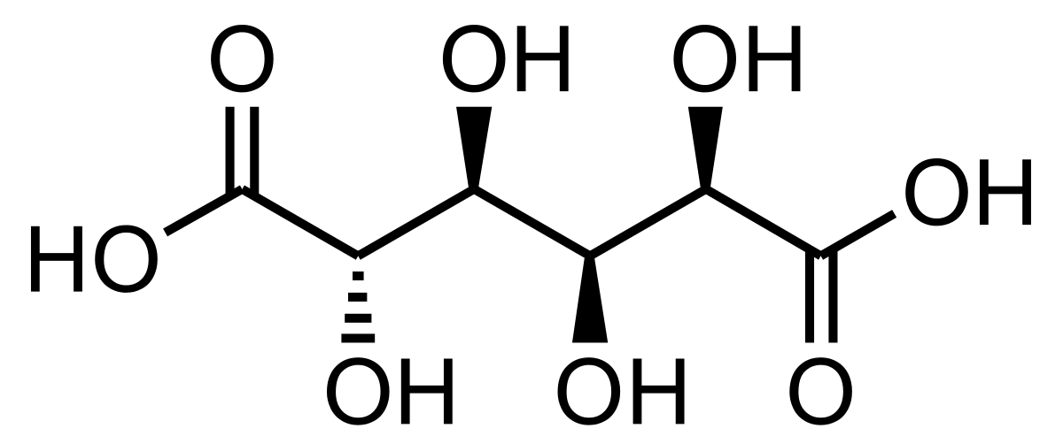
export
V_{in}
allostery
Ino1
S.cerevisiae
MIOX
M. musculus
SuhB
Udh
myoinositol-
1-phosphate
glucuronic
acid
myoinositol
glucaric acid
glucose-6-phosphate
Zwf
Pgi
fructose-6-phosphate
PfkA

Slide 10
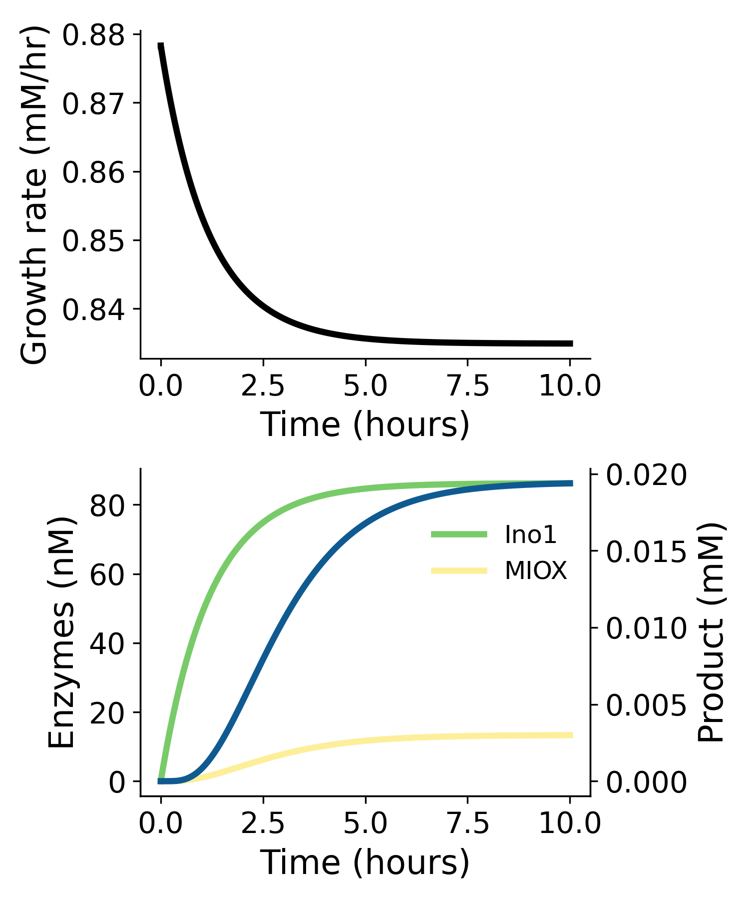
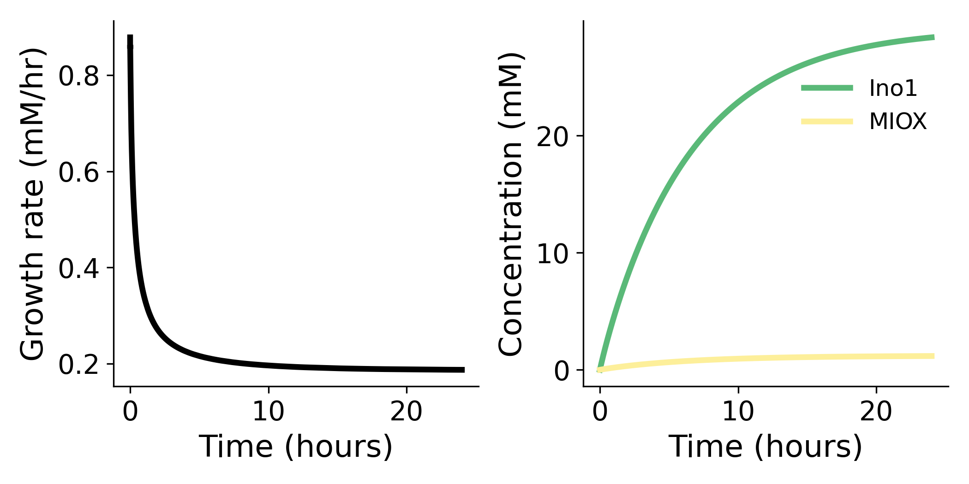
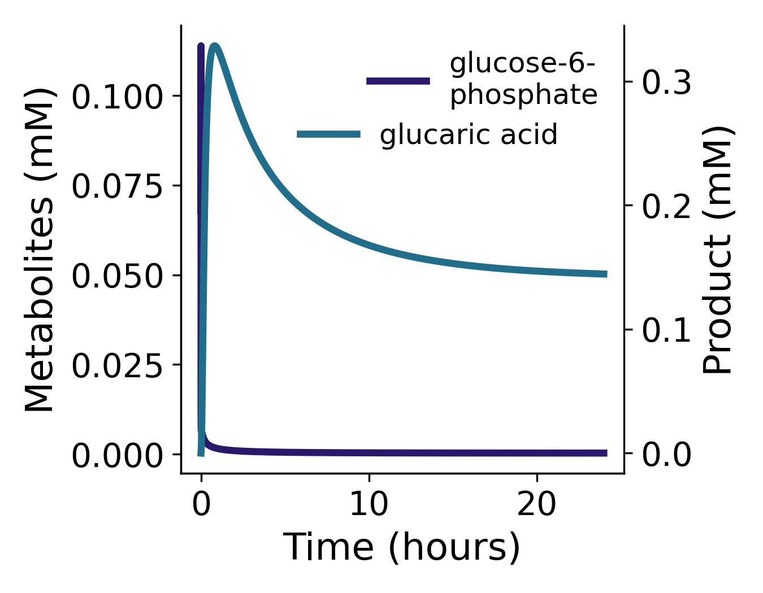
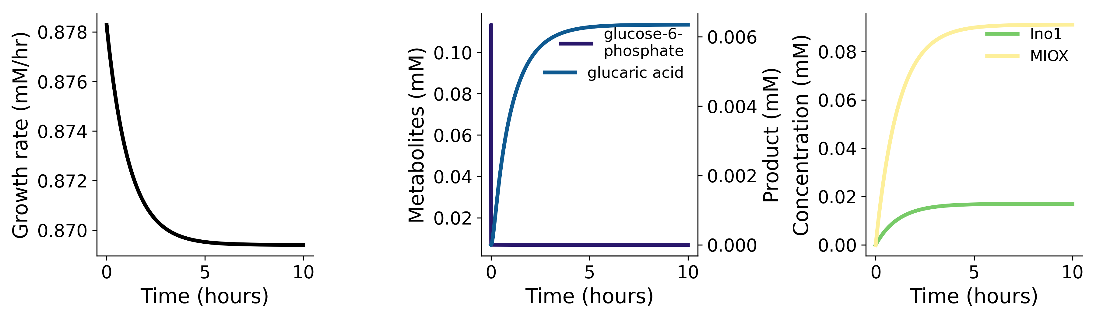

Slide 11
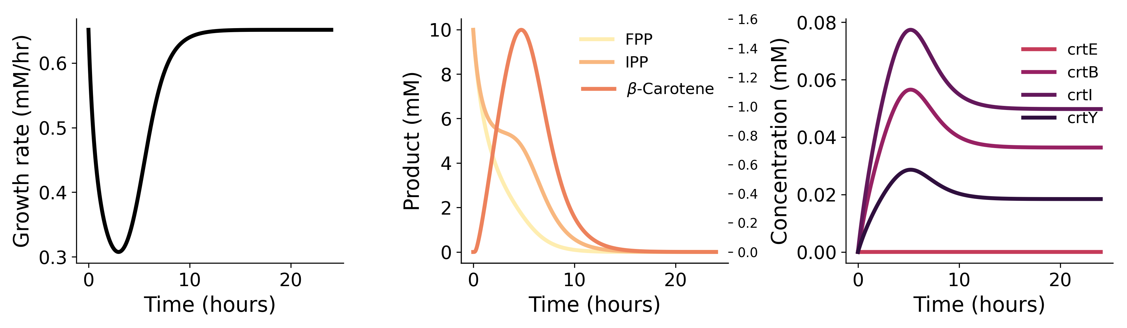
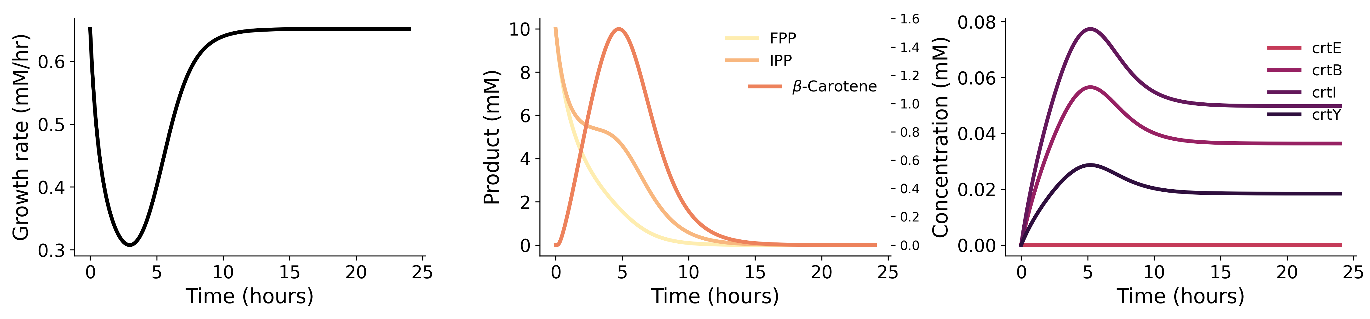

Slide 12
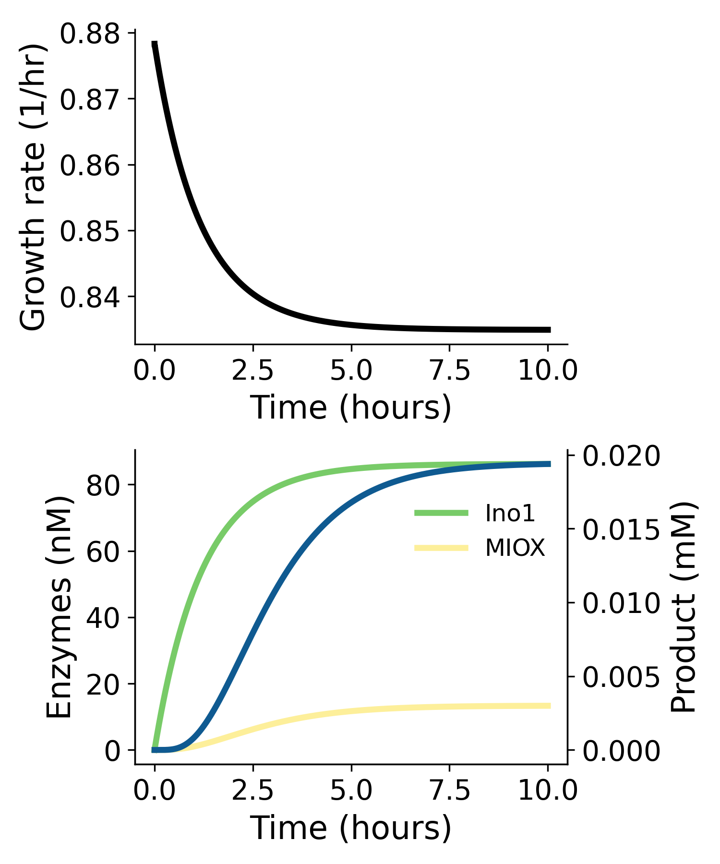
A
B
export
V_{in}
allostery
Ino1
S.cerevisiae
MIOX
M. musculus
SuhB
myoinositol-
1-phosphate
glucuronic
acid
myoinositol
glucose-6-phosphate
Udh
Zwf
Pgi
upstream repression
IpsA
C. glutamicum
fructose-6-phosphate
downstream activation
PfkA
glucaric acid
C
IPP
V_{ipp}
V_{in}
crtE
crtB
crtI
crtY
GGPP
Phytoene
Lycopene
FPP
β-carotene
V_{fpp}
D

Slide 13
Figure 3
Medium conditions experiments and knockouts

Slide 14
glucose-6-phosphate
galactose
glucose
fructose
fructose-6-phosphate
mannitol
glucosamine
sorbitol
xylose
glyceraldehyde-3-phosphate
glycerol
ribose
gluconate
pyruvate
L-alanine
lactate
acetate
acetyl-CoA
succinate

Slide 15
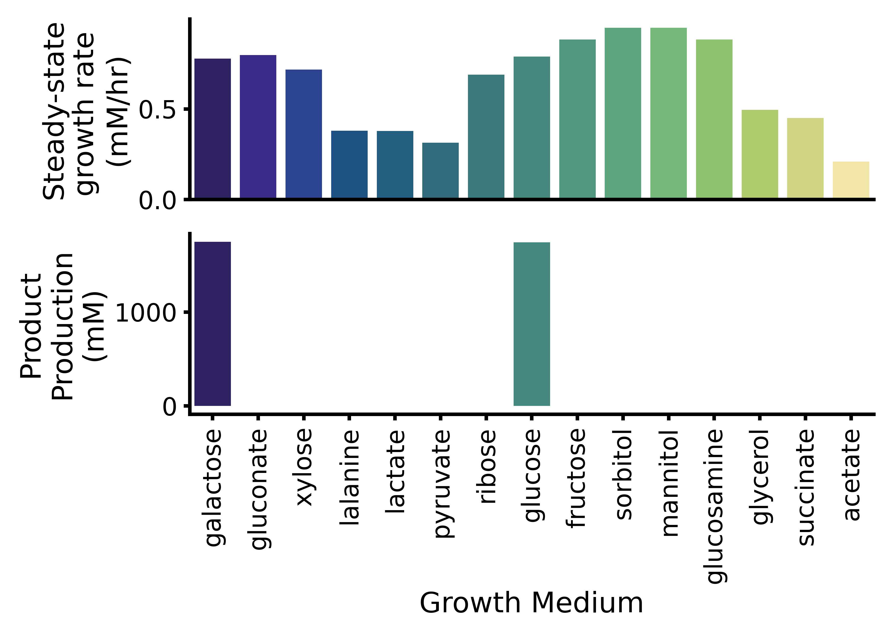

Slide 16
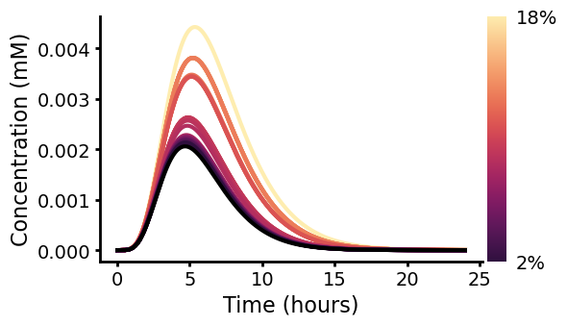
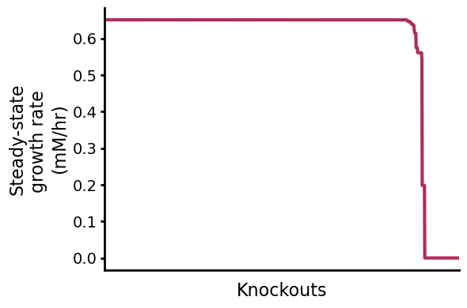
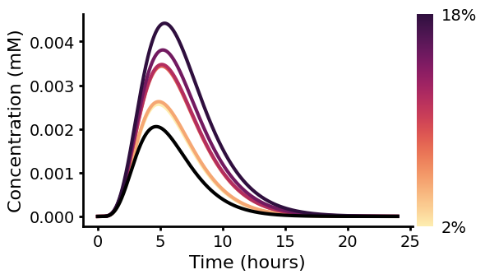
WT
β-carotene (mM)
Growth defect
Time (hrs)

Slide 17
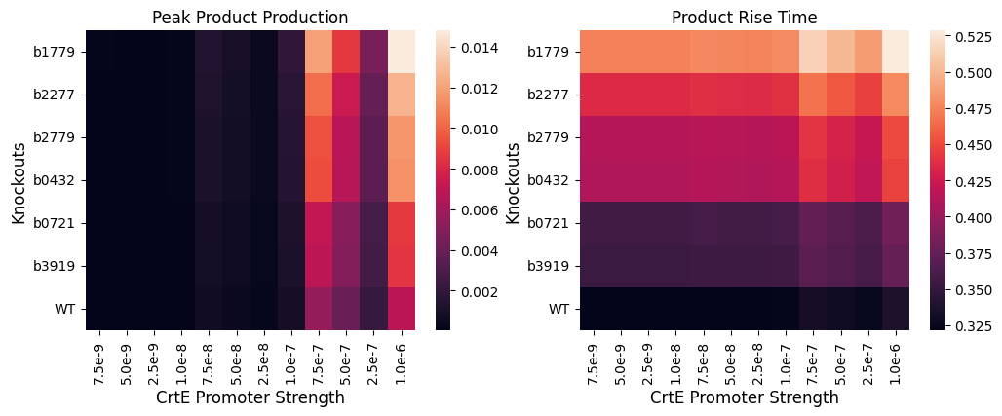
Peak Beta-Carotene (mM)
Beta-Carotene Rise Time (mM)

Slide 18
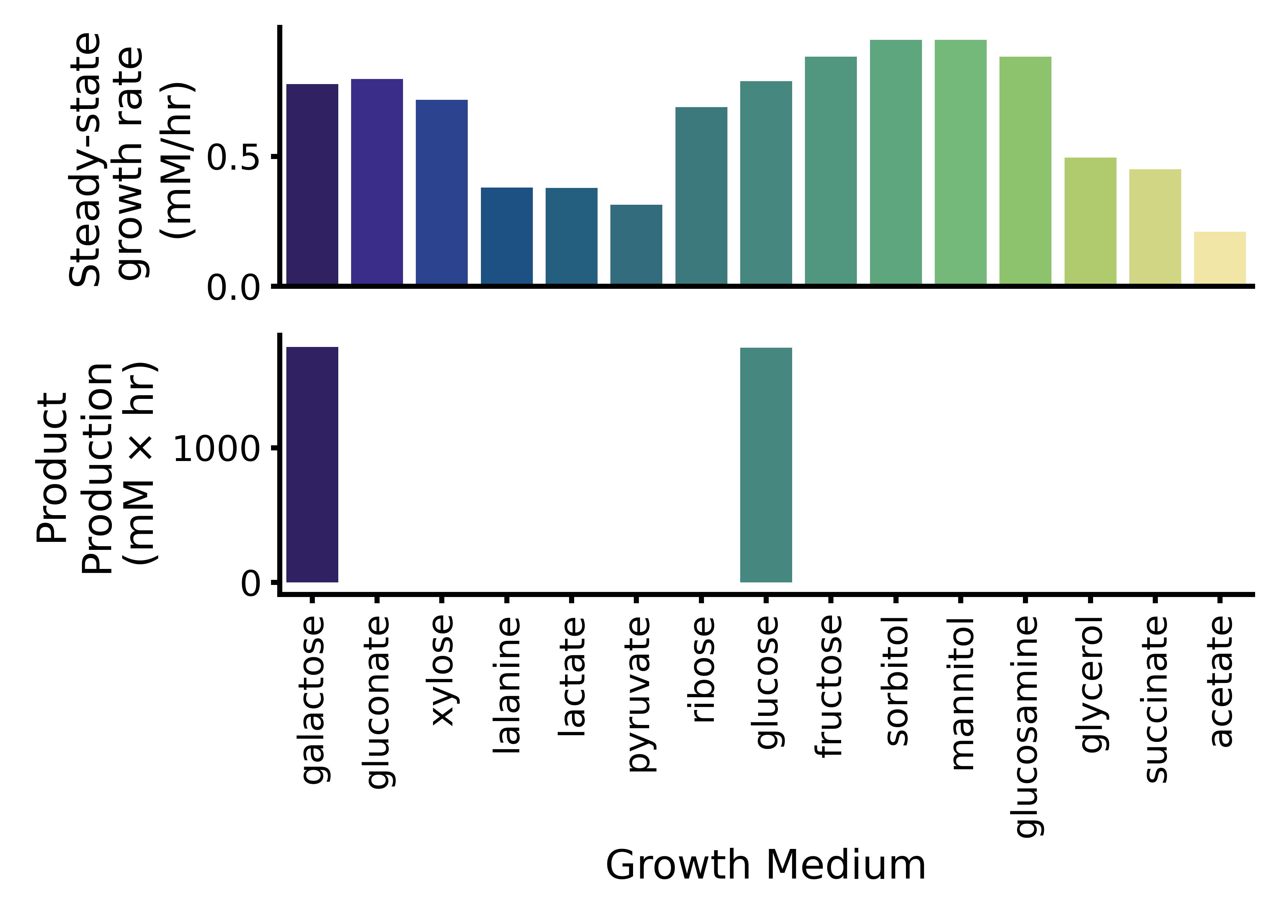
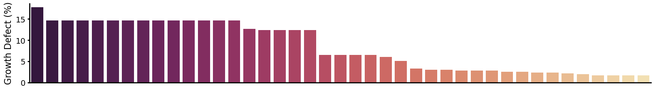
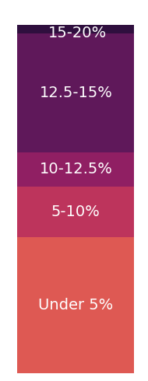
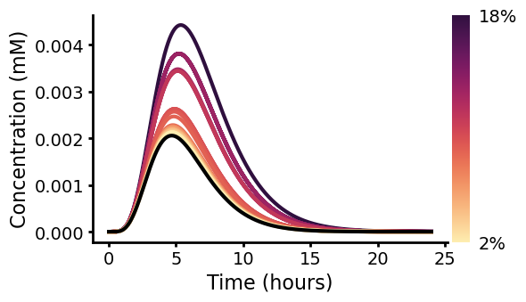
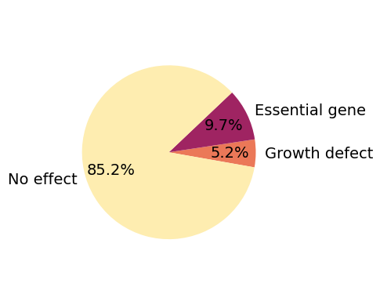
A
B
glucaric acid
glucose-6-phosphate
galactose
glucose
fructose
fructose-6-phosphate
mannitol
glucosamine
sorbitol
xylose
glyceraldehyde-3-phosphate
glycerol
ribose
gluconate
pyruvate
L-alanine
lactate
acetate
acetyl-CoA
succinate
C
D
E

Slide 19
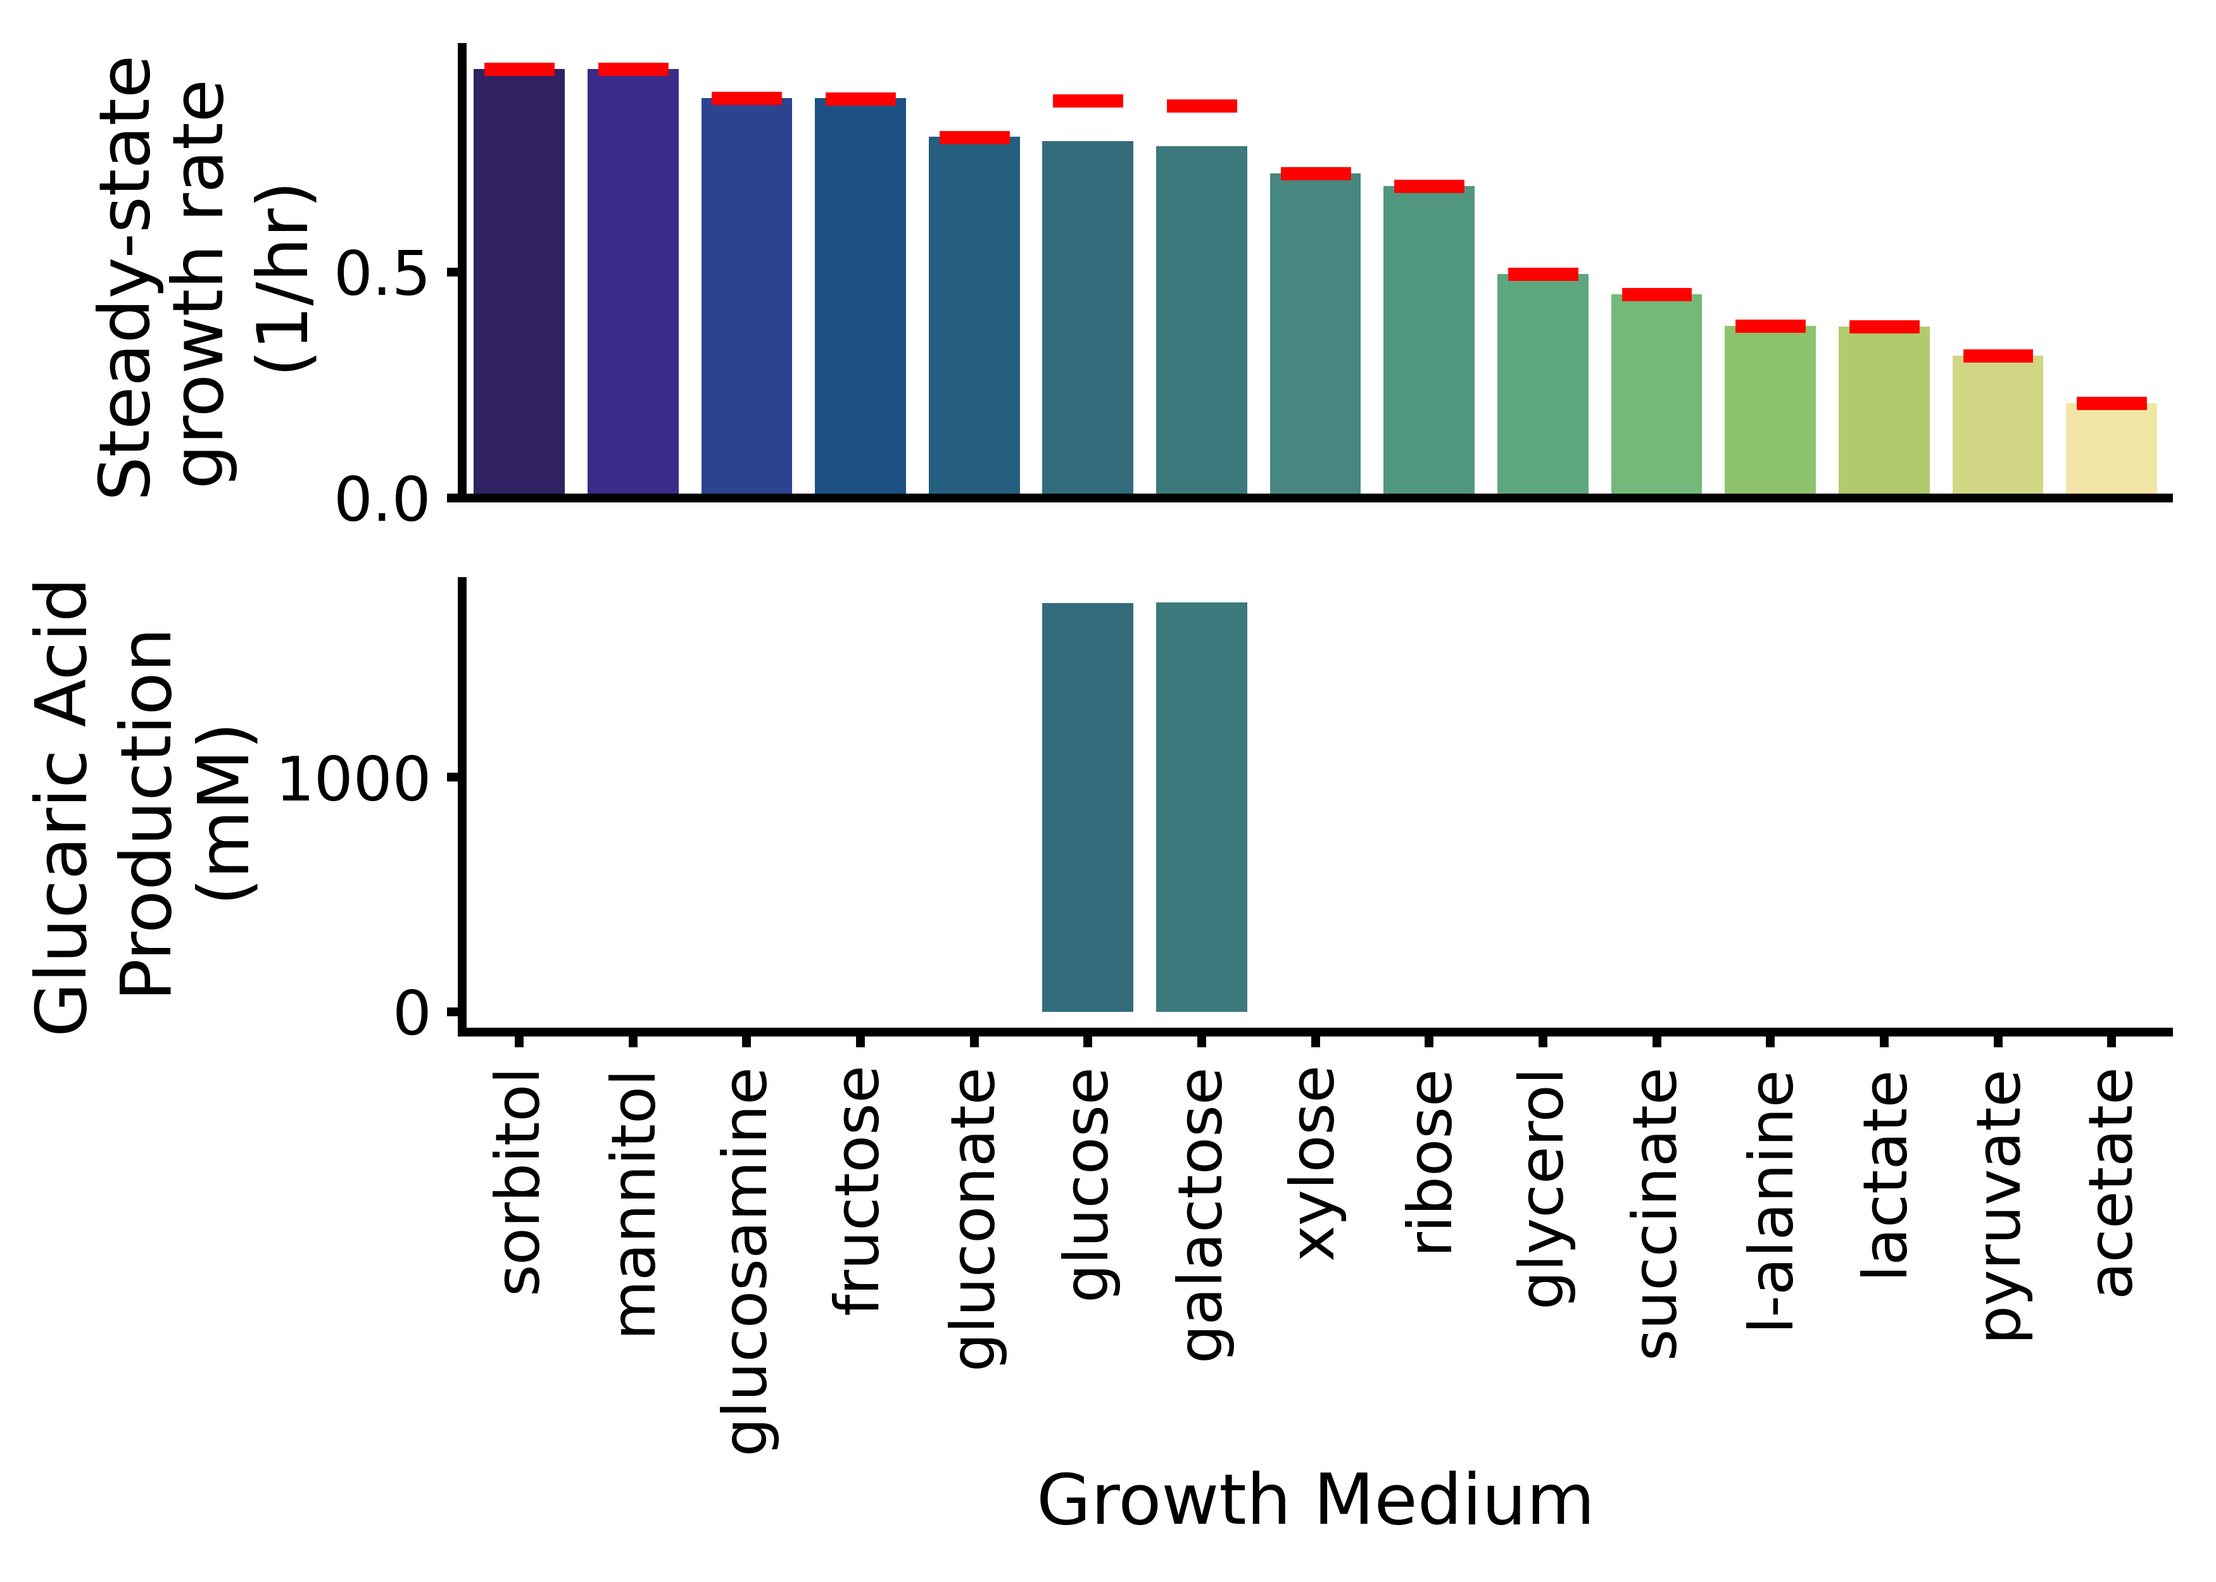
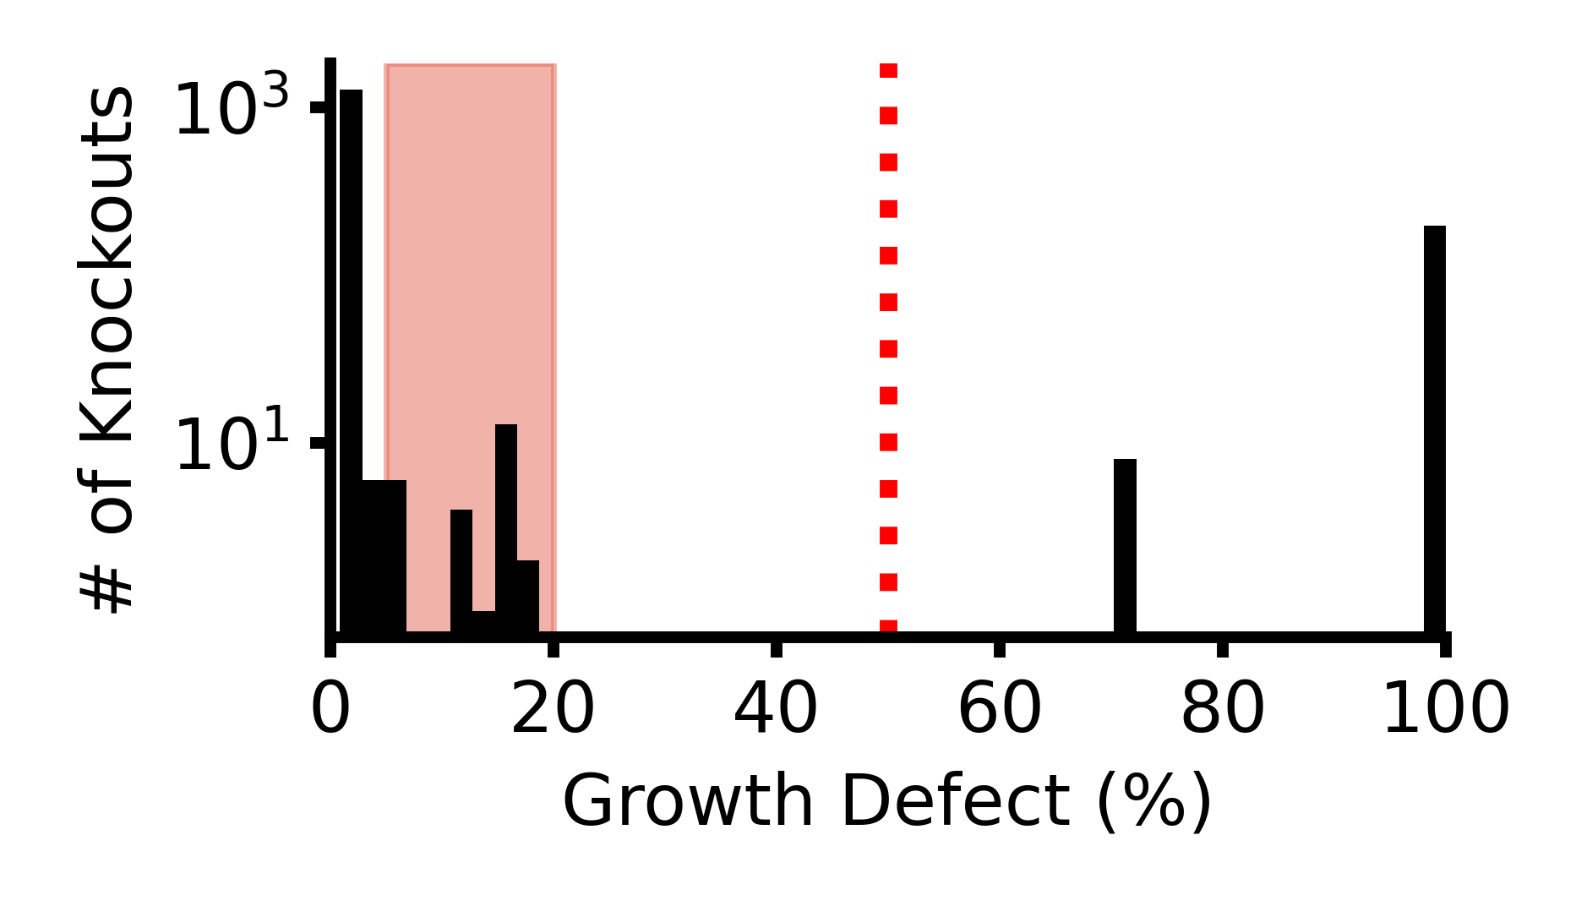
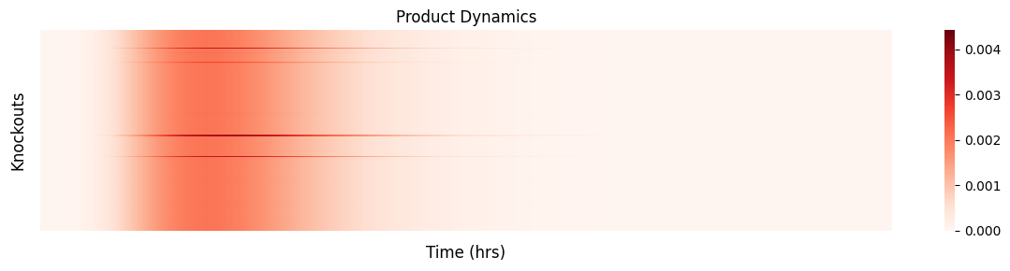
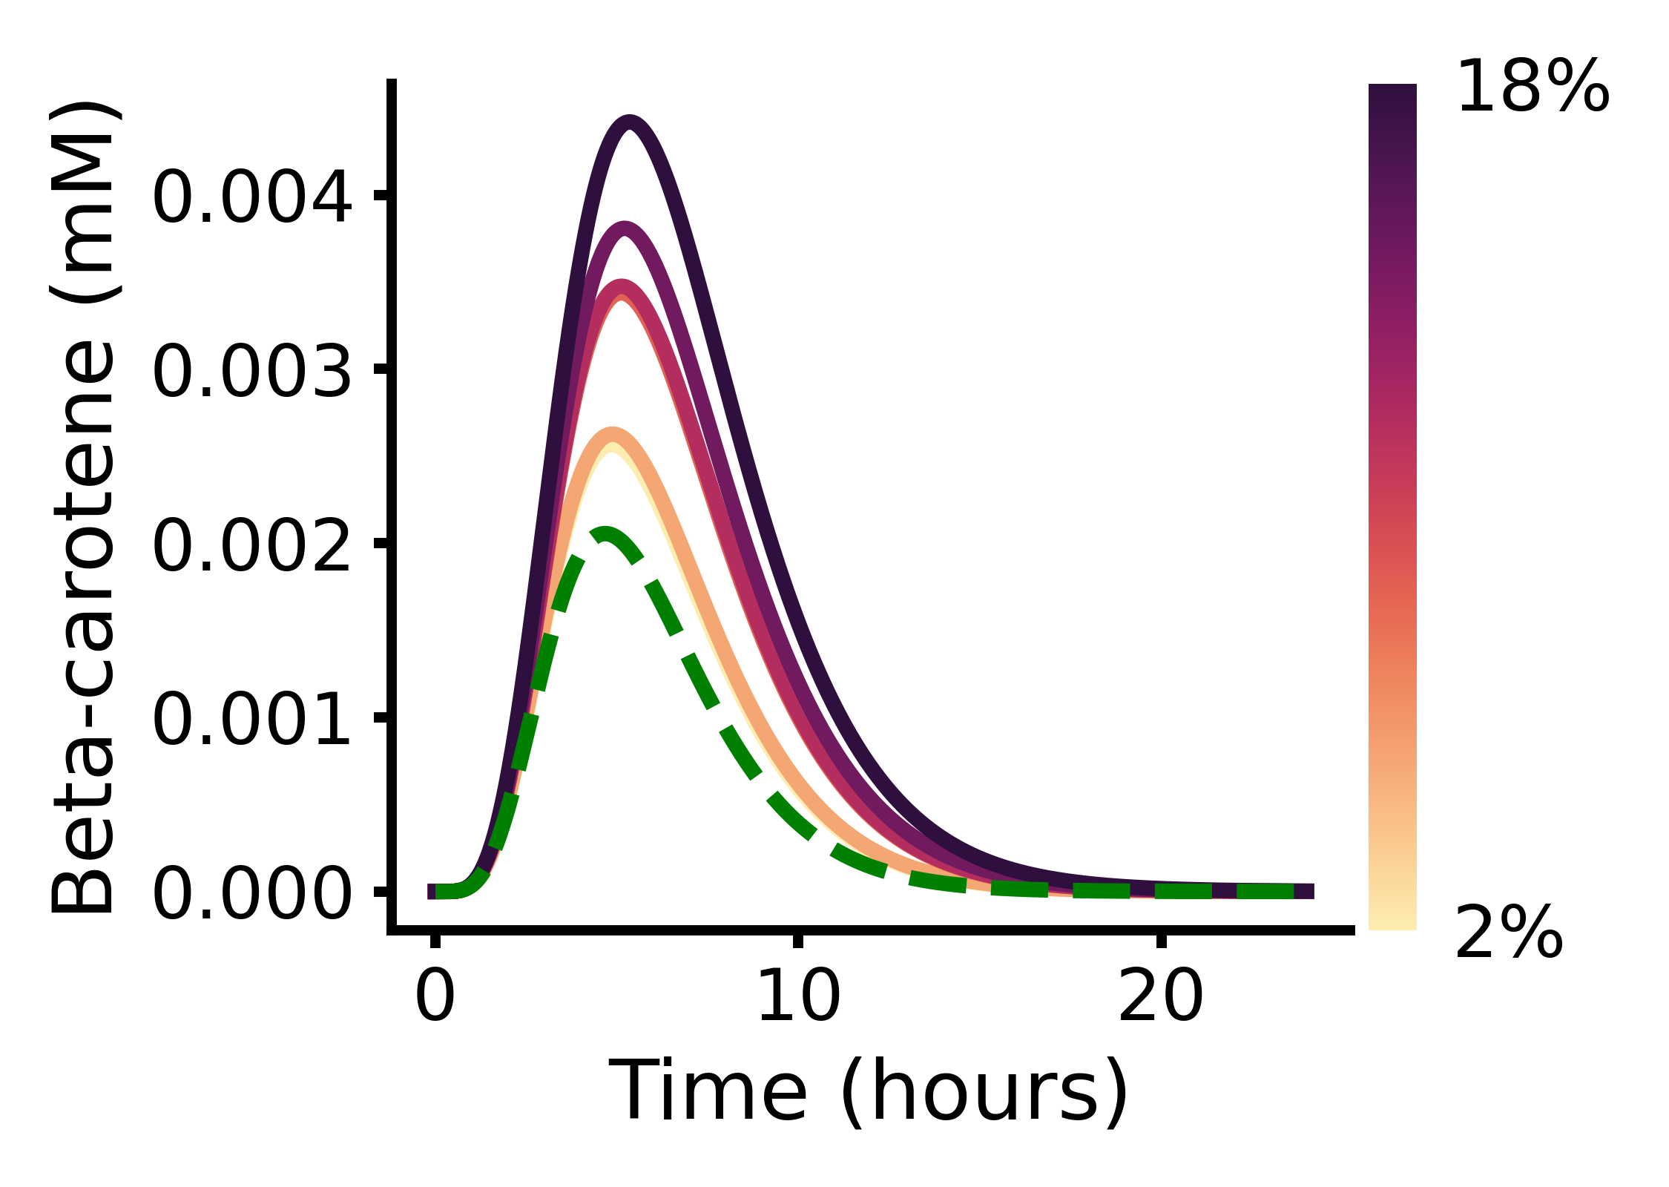
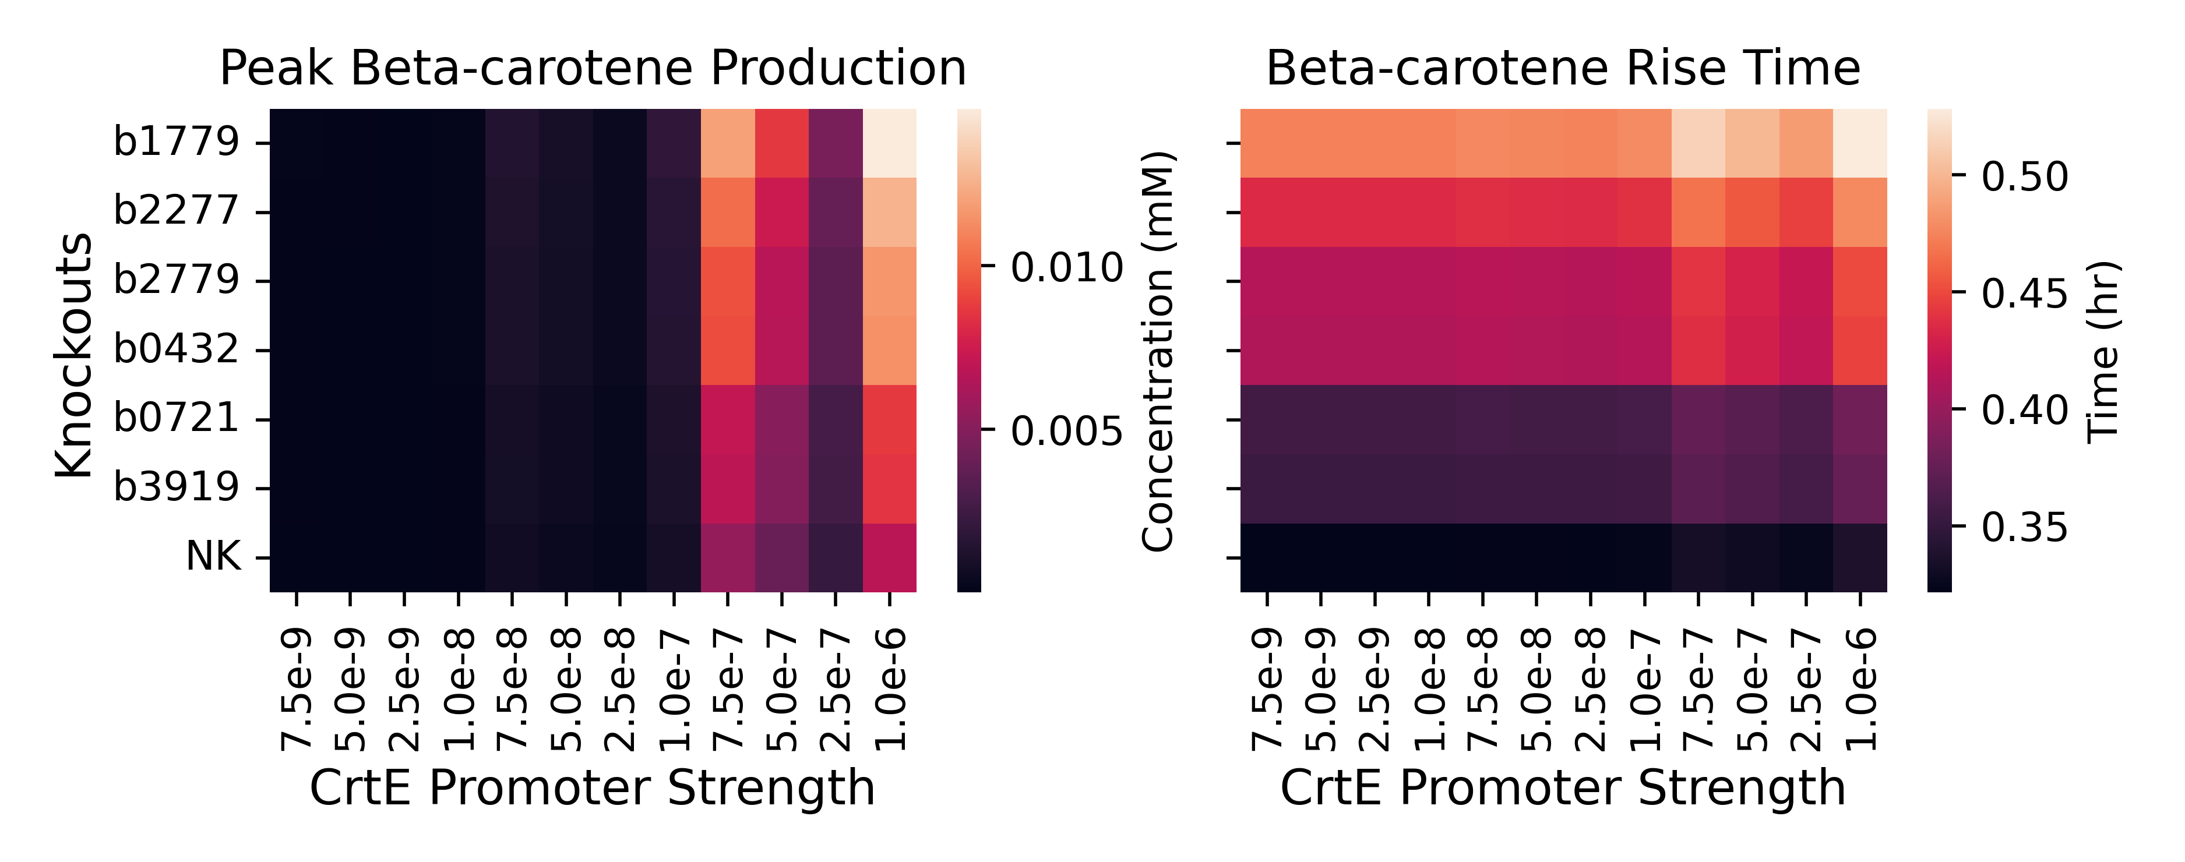
A
B
9.3%
10.3%
glucaric acid
glucose-6-phosphate
galactose
glucose
fructose
fructose-6-phosphate
mannitol
glucosamine
sorbitol
xylose
glyceraldehyde-3-phosphate
glycerol
ribose
gluconate
pyruvate
L-alanine
lactate
acetate
acetyl-CoA
succinate
C
intermediate
D
Beta-carotene Dynamics
essential
Knockouts
Concentration (mM)
Time (hrs)
E
NK
F
Growth defect

Slide 20
Figure 4
Bayesopt and burden experiments

Slide 21
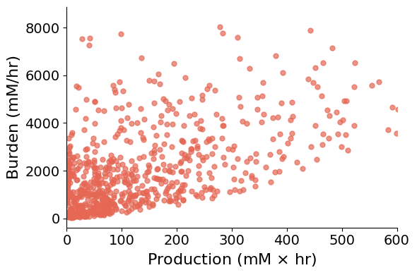
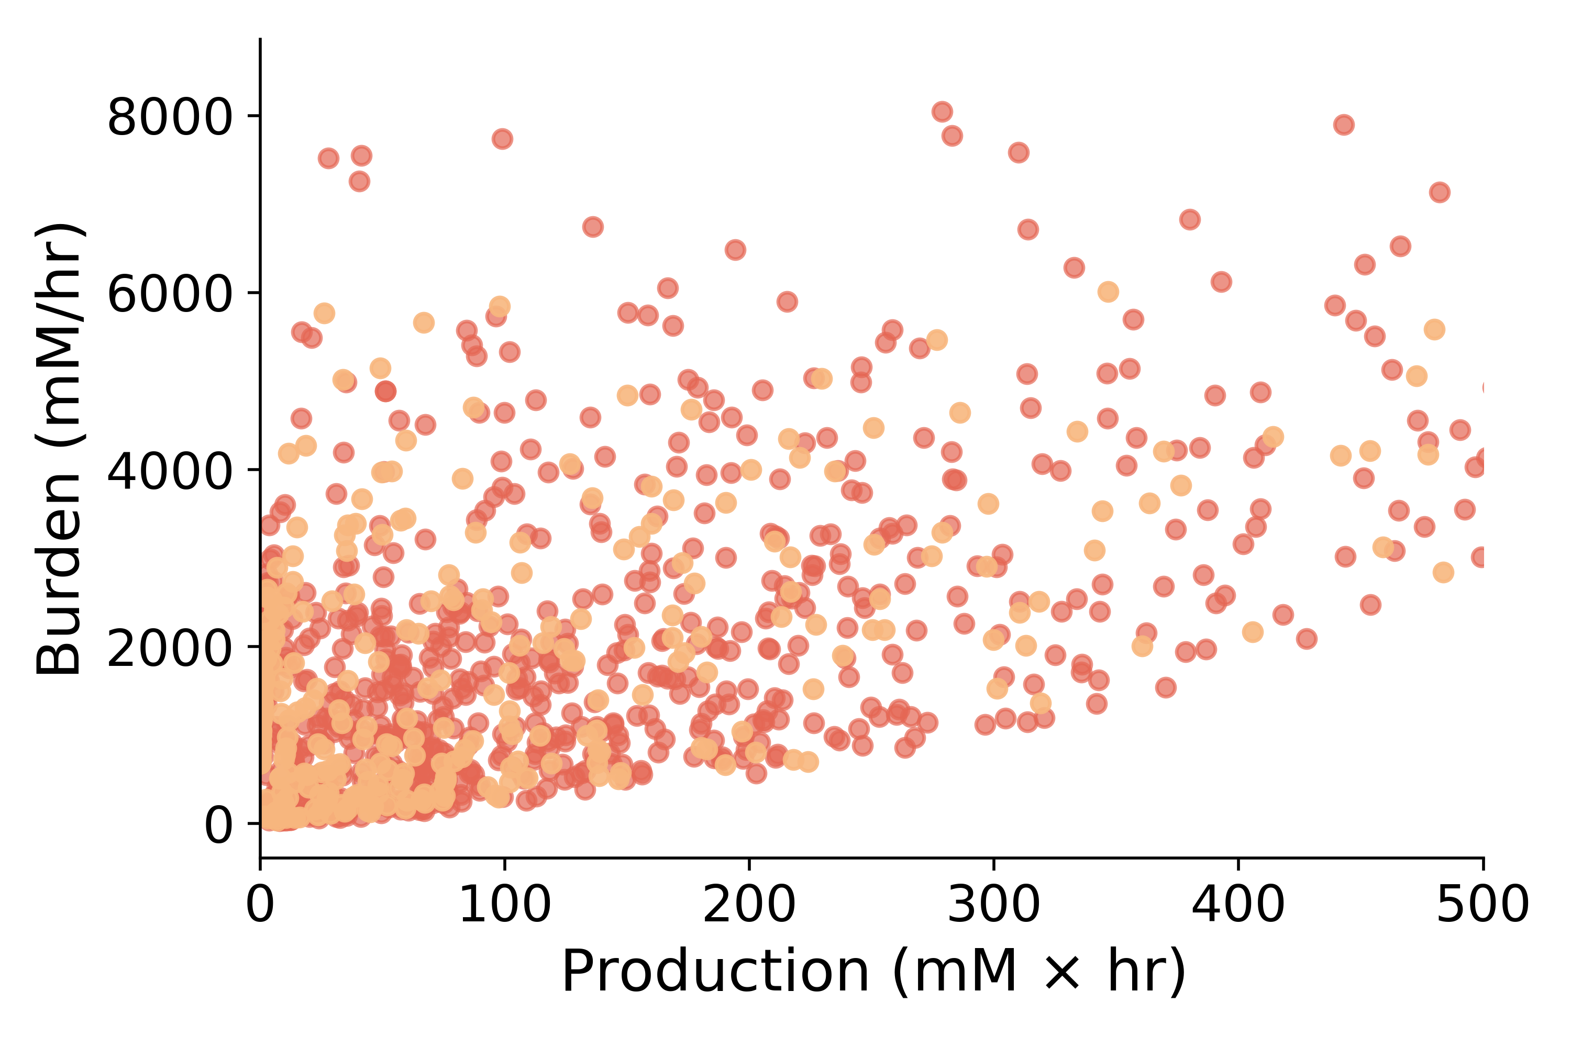
production
burden
product
growth
time
time

Slide 22
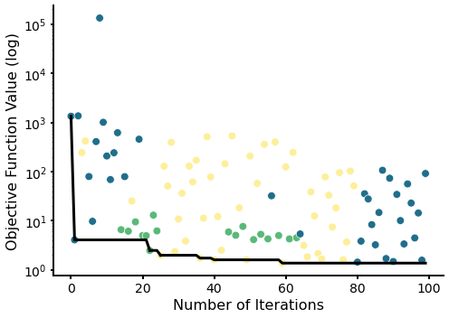
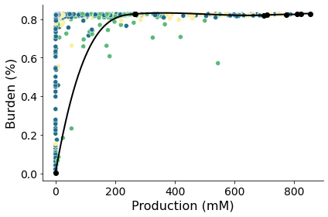

Slide 23
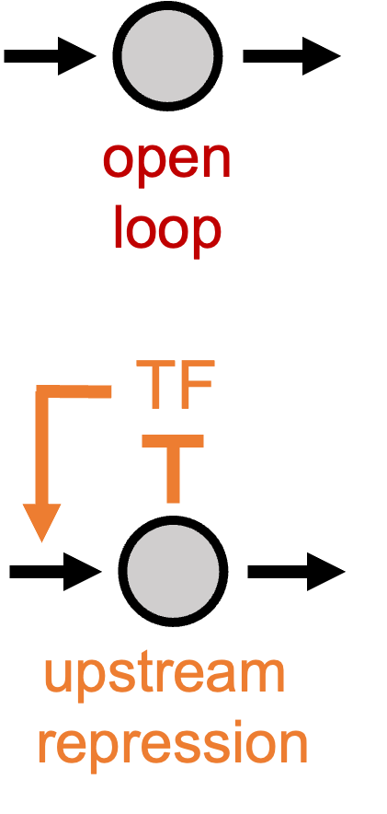
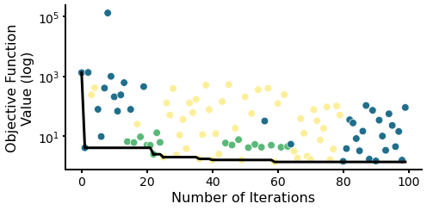
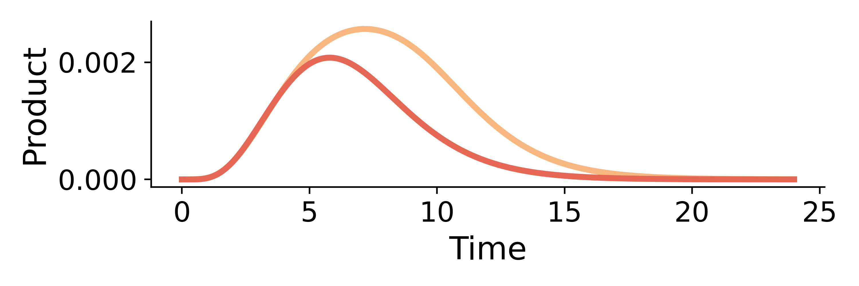
A
B
E
TF
TF
production
burden
product
growth
open
loop
upstream
repression
downstream
activation
time
time
F
C
G
D

Slide 24
V_{ipp}
V_{in}
open loop control
IPP
GGPP
Phytoene
Lycopene
β-carotene
FPP
crtE
crtB
crtI
crtY
V_{fpp}
negative feedback loop
V_{ipp}
V_{in}
IPP
GGPP
Phytoene
Lycopene
β-carotene
FPP
crtE
crtB
crtI
crtY
V_{fpp}

Slide 25
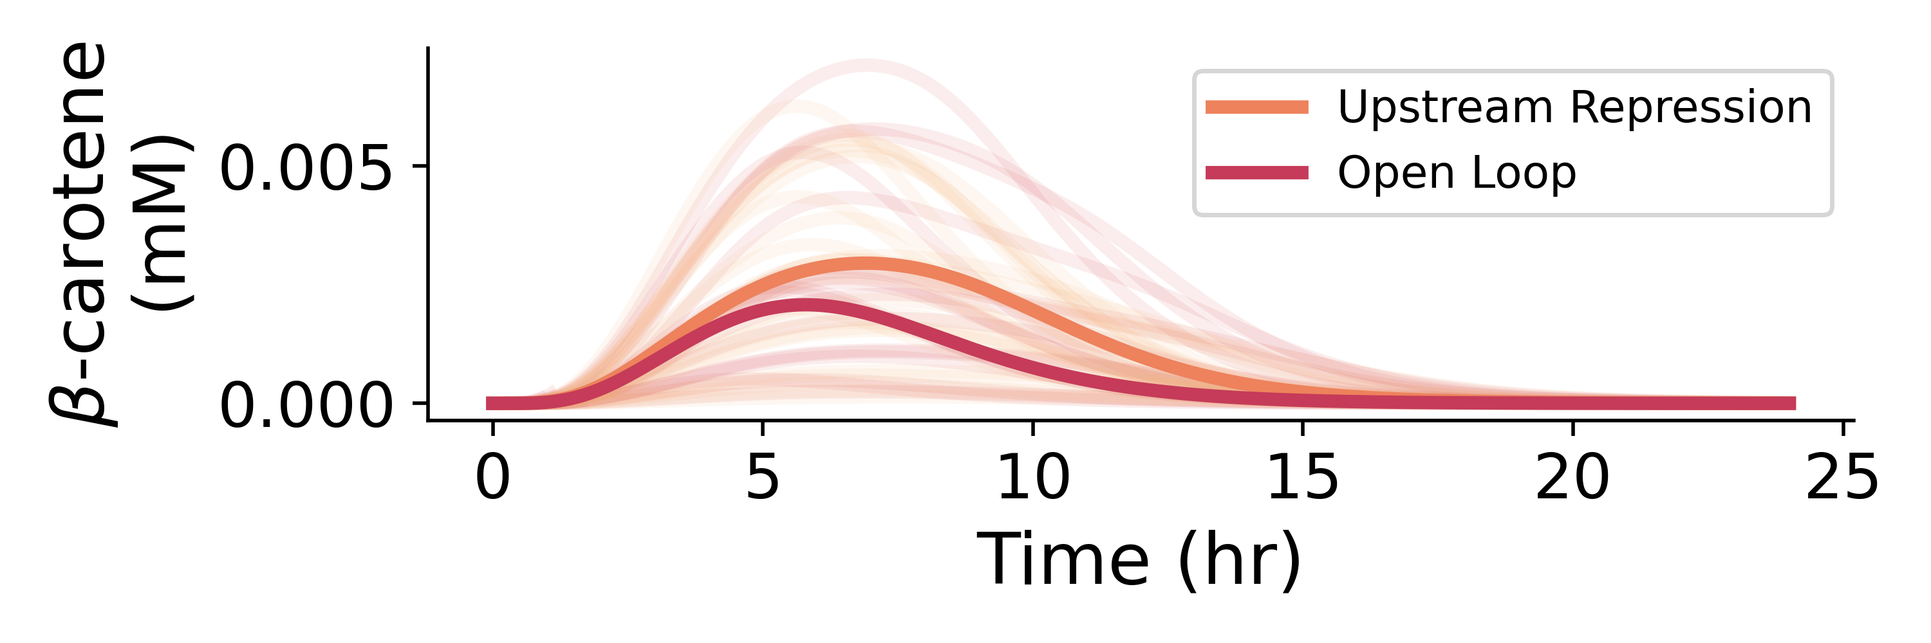

Slide 26
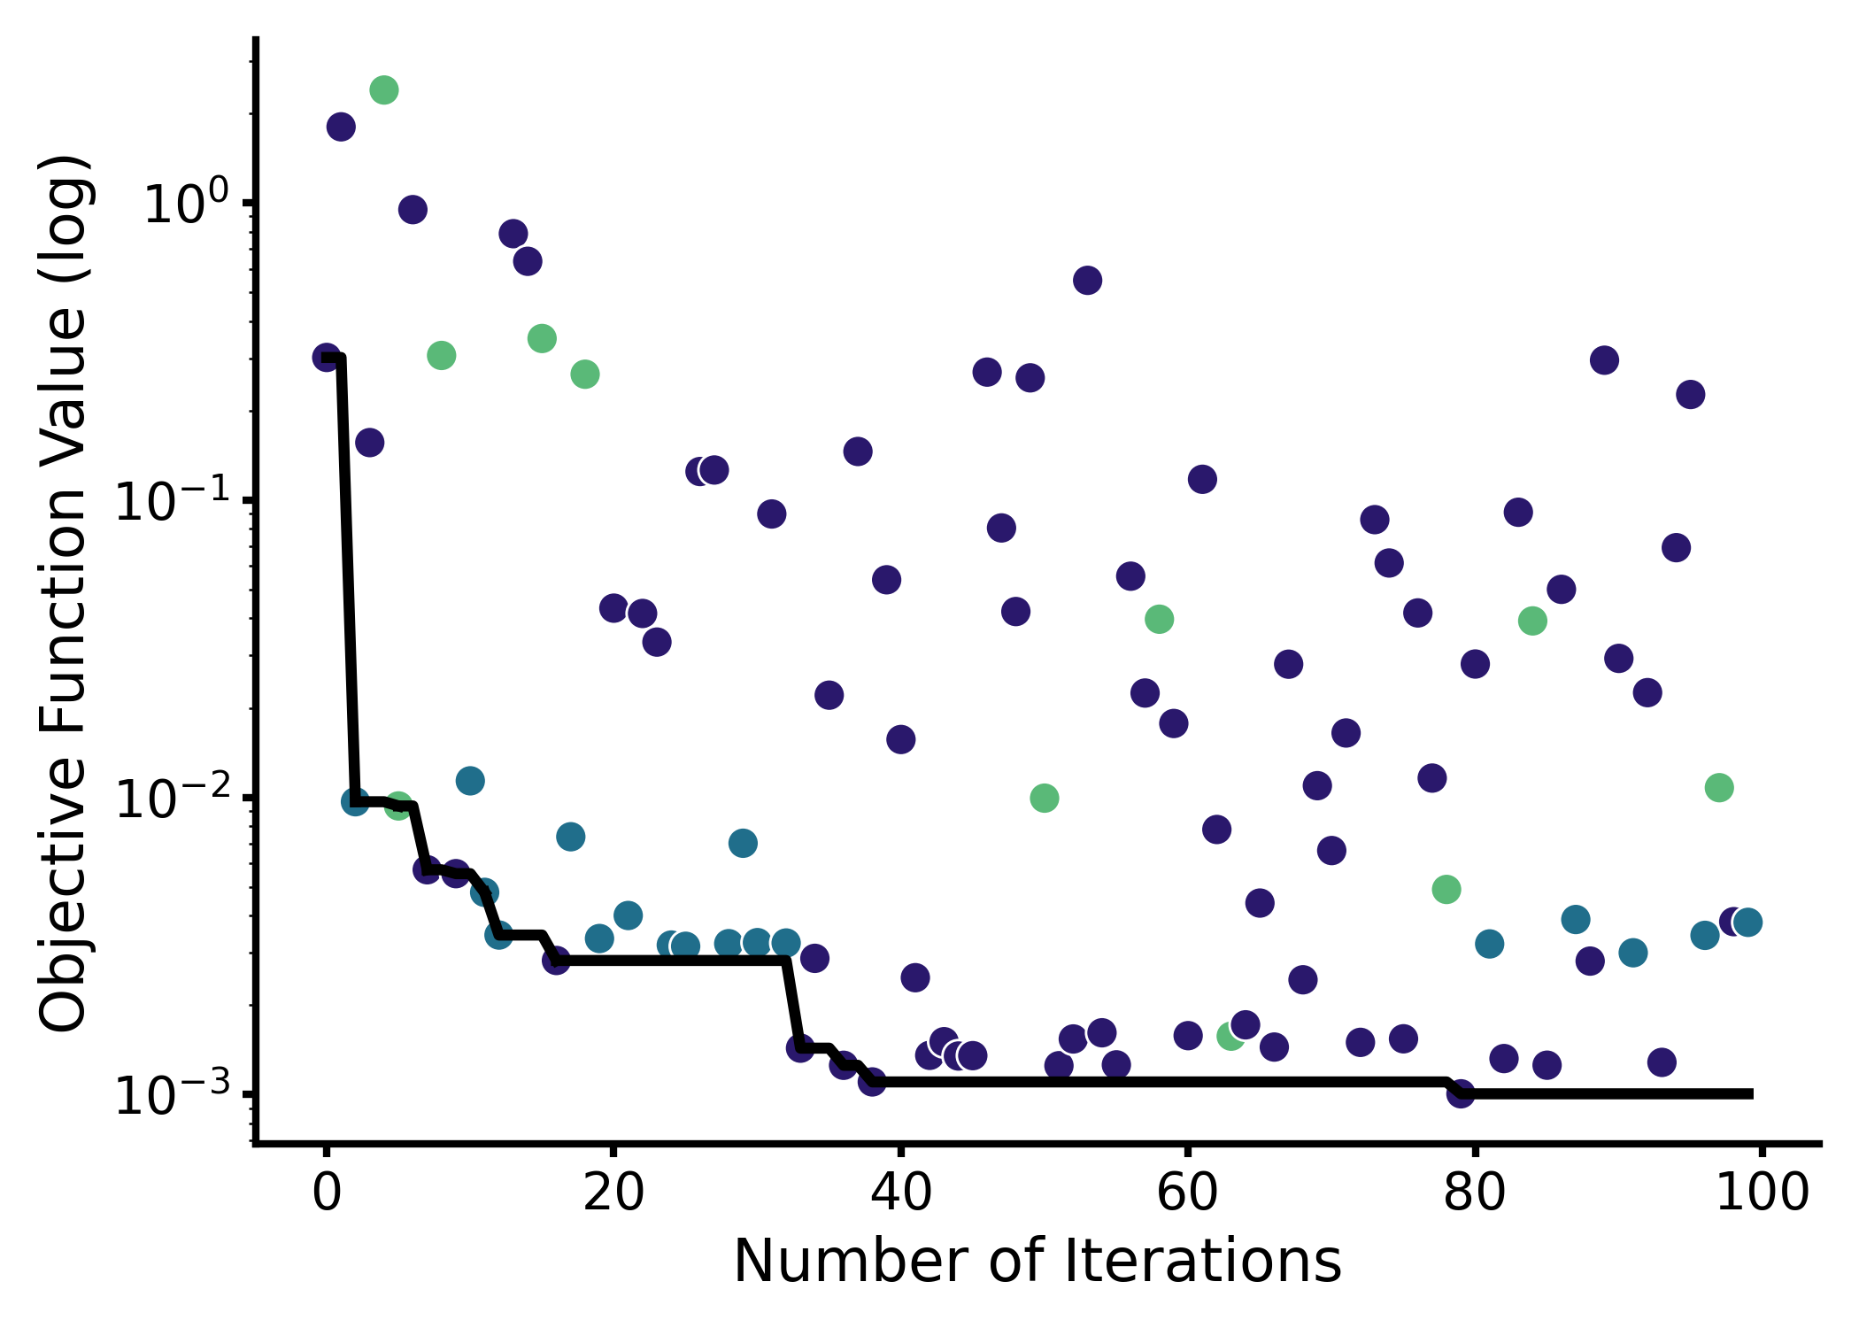
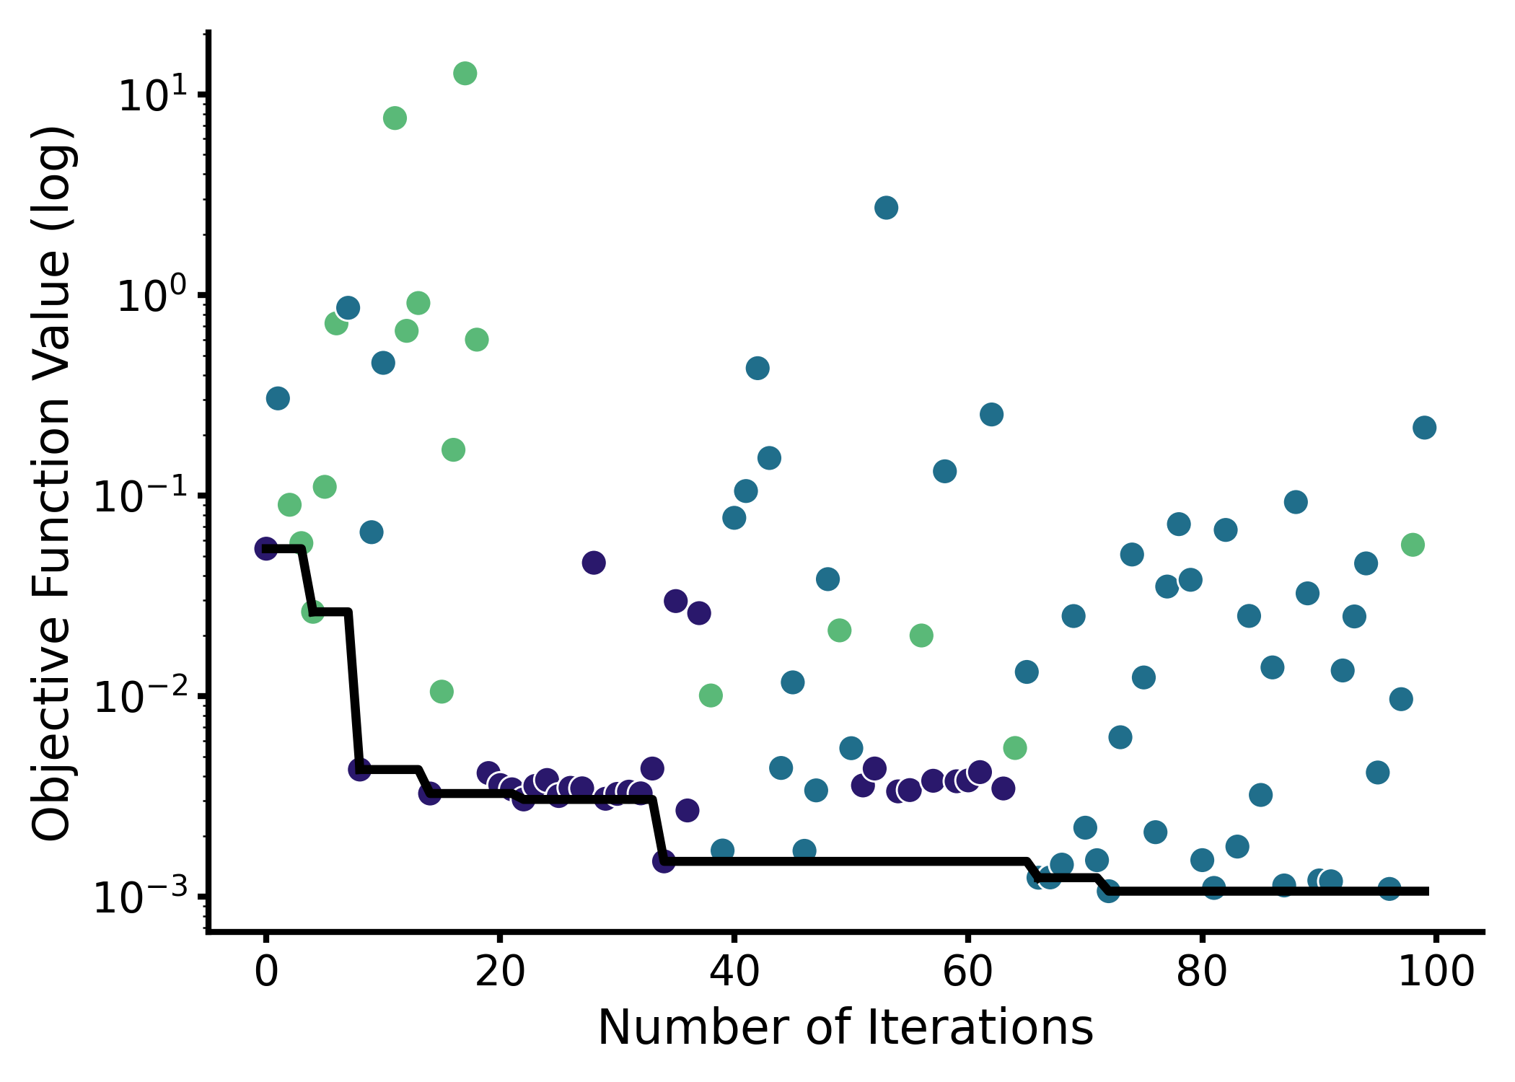
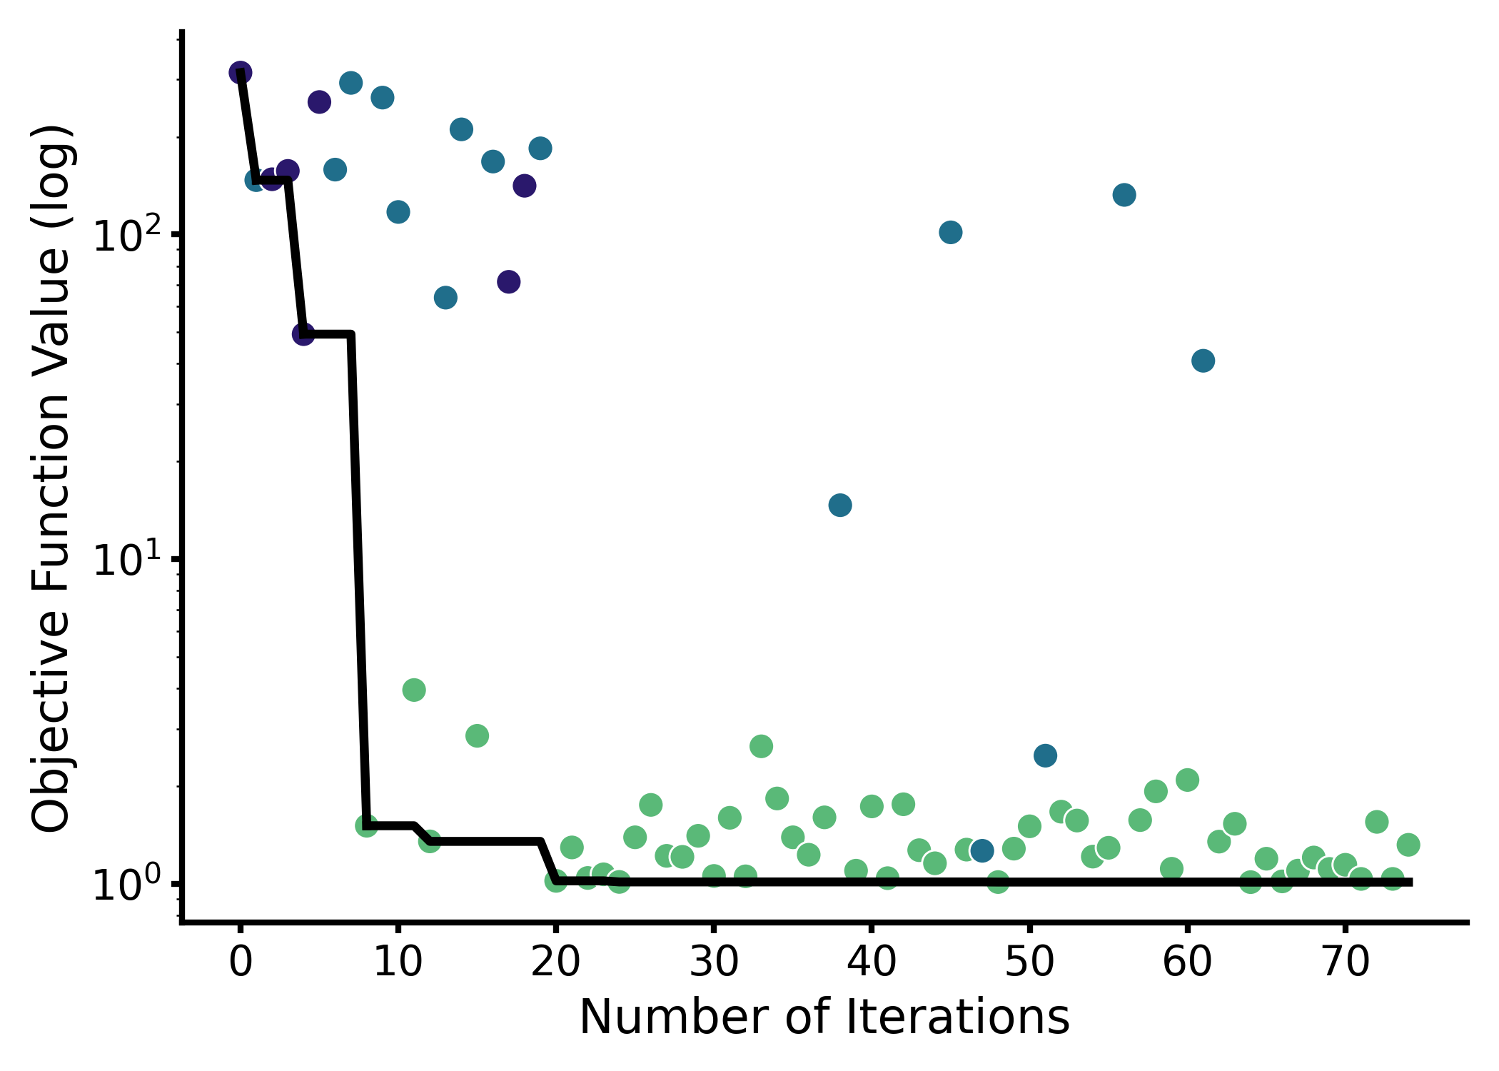

Slide 27
export
allostery
open loop control
V_{in}
Ino1
SuhB
Udh
MIOX
glucuronic
acid
glucose-6-phosphate
myoinositol-
1-phosphate
myoinositol
glucaric acid
export
allostery
upstream repression
V_{in}
Ino1
SuhB
Udh
MIOX
glucuronic
acid
glucose-6-phosphate
myoinositol-
1-phosphate
myoinositol
glucaric acid
export
allostery
downstream activation
V_{in}
Ino1
SuhB
Udh
MIOX
glucuronic
acid
glucose-6-phosphate
myoinositol-
1-phosphate
myoinositol
glucaric acid
export
allostery
dual control
V_{in}
Ino1
SuhB
Udh
MIOX
glucuronic
acid
glucose-6-phosphate
myoinositol-
1-phosphate
myoinositol
glucaric acid

Slide 28
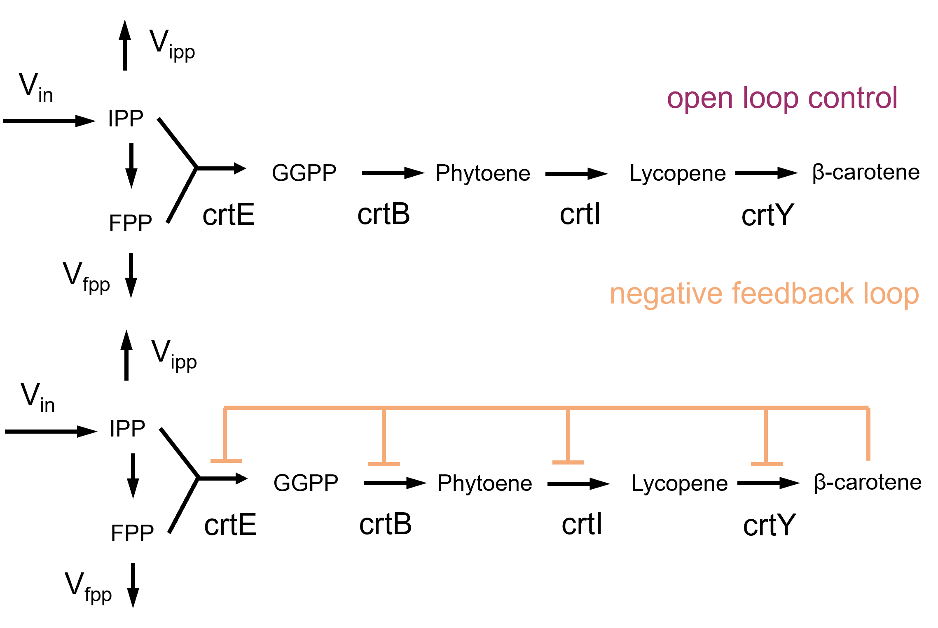





A
B
N = 1000
C
D
α = 0
α = 0.5
α = 1
Maximum production
Balanced production
and growth defect
Minimum growth defect
open loop control
upstream repression
downstream activation
dual control

Slide 29
Supplementary Figures

Slide 30
P₁
P₁
V₃
V₁
V_{p}
V₁
V_{in}
P
V_{p}
V₂
V₂
V_{p}
P₂
V₁
P₁
V_{p}
P₂
V₄
V₂
V₁
P₁
V_{p}
P₂
V₂
P₂
V₃

Slide 32




A
B
C
D

Slide 33




A
B
C
D

